Slide 1

Knowledge Graph
汤斯亮（Siliang Tang）
siliang@zju.edu.cn

Slide 2
Outlines
What is a Knowledge Graph?
How to Construct a Knowledge Graph?
Mention Detection
Mention Disambiguation
Entity Typing (Fine-grained)
Relation Extraction
Knowledge Graph Reasoning
Path-Based Reasoning
Embedding-Based Reasoning
Bridging Path-Based and Embedding-Based Reasoning:
Miscellaneous
Using Knowledge Bases to Inform Neural Models
Probing Knowledge in LMs
Multimodal Knowledge Graphs

Slide 3
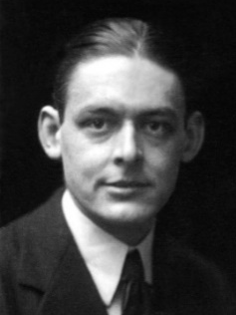
What is a knowledge?
Plato’s definition: Justified true belief
Build the best Knowledge Graph in industry that will provide the highest quality of world‘s knowledge and personal knowledge measured by correctness, coverage, freshness &usage, to enable Agile ,intelligent knowledge experiences
Where is the wisdom we have lost in knowledge?
Where is the knowledge we have lost in information?
— Thomas Stearns Eliot
WISDOM
KNOWLEDGE
INFORMATION
DATA

Slide 4
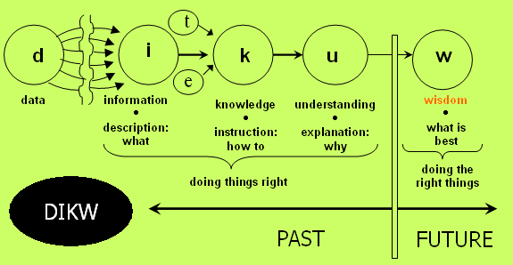
From Data to Knowledge
The ultimate goal of AI is not just answering questions, but raise questions.

Slide 5
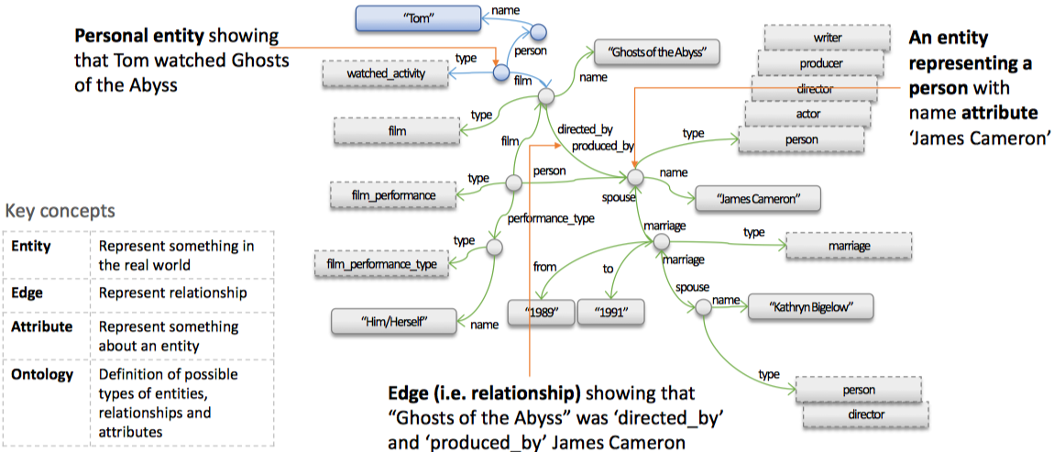
What is a knowledge graph?
Knowledge in graph form
Captures entities, attributes, and relationships
Nodes are entities
Nodes are labeled with attributes
Typed edges between two nodes capture a relationship between entities

Slide 6
State of the art knowledge graphs
Minimum set of characteristics of knowledge graphs:
mainly describes real world entities and their interrelations, organized in a graph.
deﬁnes possible classes and relations of entities in a schema.
allows for potentially interrelating arbitrary entities with each other.
covers various topical domains.
State of Art KGs:
Large vertical KGs
Cyc and Open Cyc
Freebase
Wikidata
DBpedia
YAGO
NELL
Google Knowledge Vault
Google KG
Microsoft Satori KG
Facebook (social network)
LinkedIn (people graph)
Amazon (product graph)
Large production KGs support Google and Bing Search

Slide 7
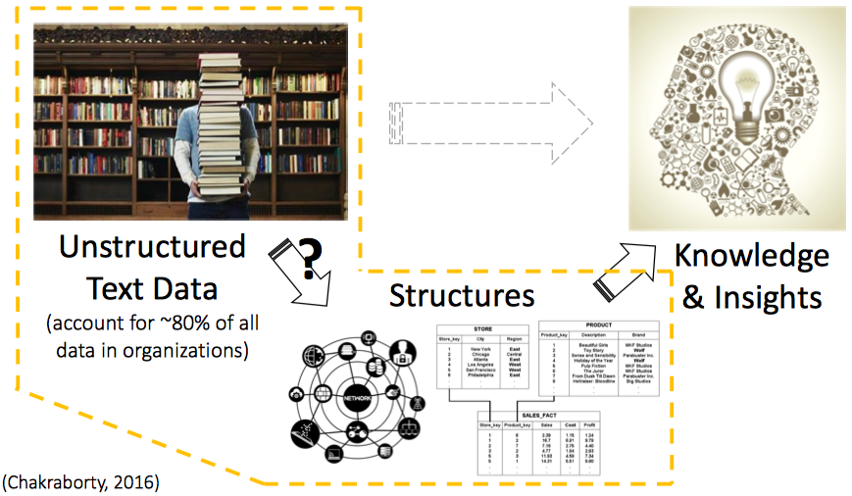
Why Knowledge Graph?
Bridge from data to human semantics
Combat information overload
Explore via intuitive structure
Tool for supporting knowledge-driven tasks

Slide 8
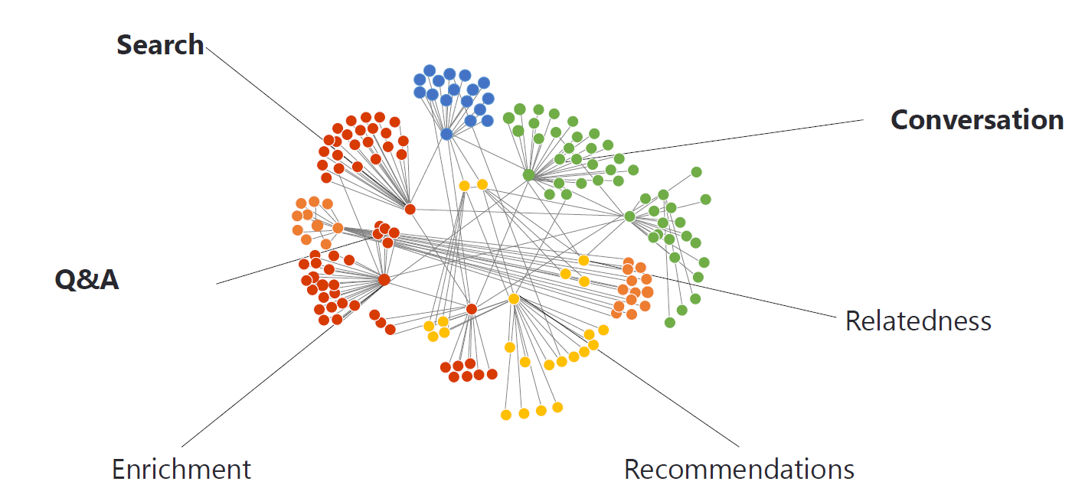
Knowledge Graph Applications

Slide 9
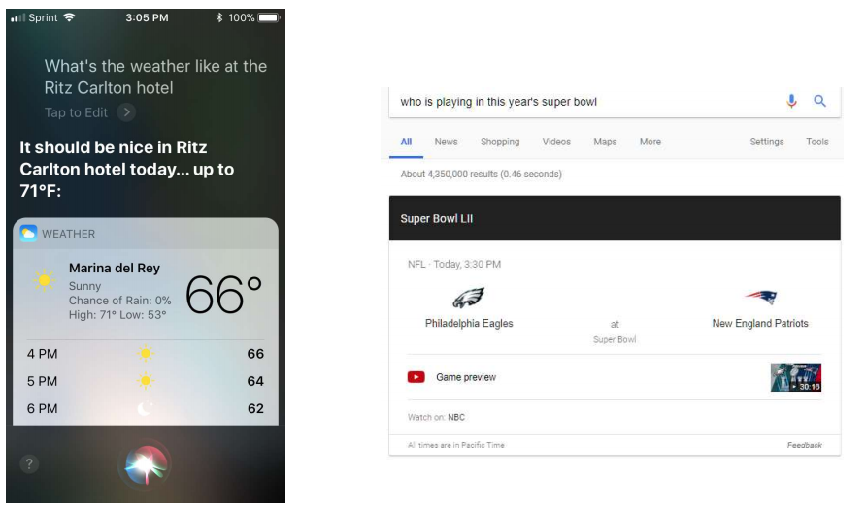
Application: QA & Search

Slide 10
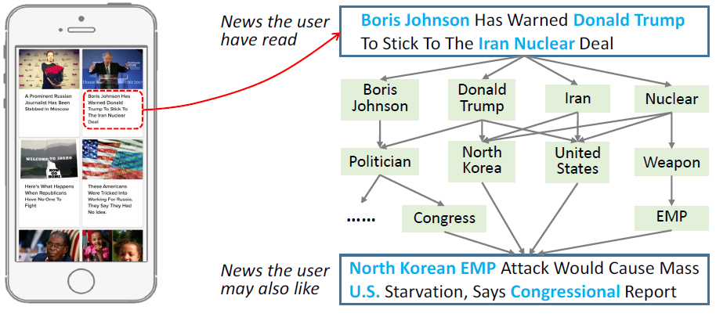
Application: Recommendation System

Slide 11
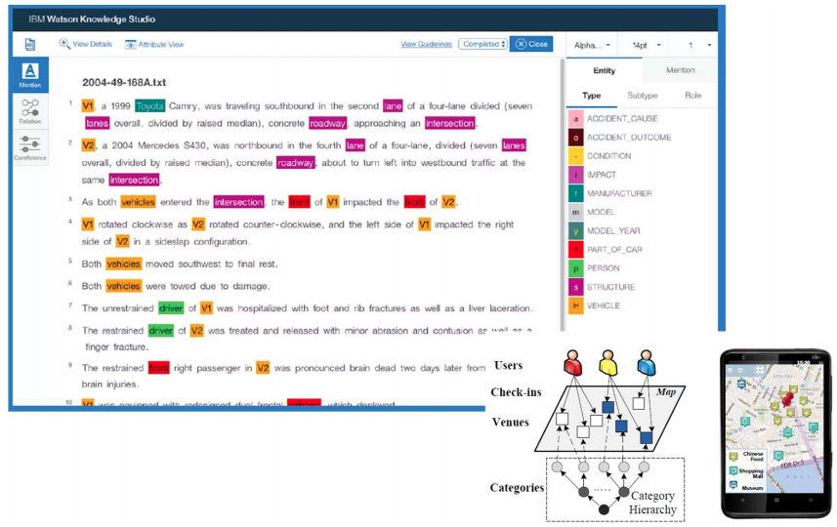
Application: Decision Support

Slide 12
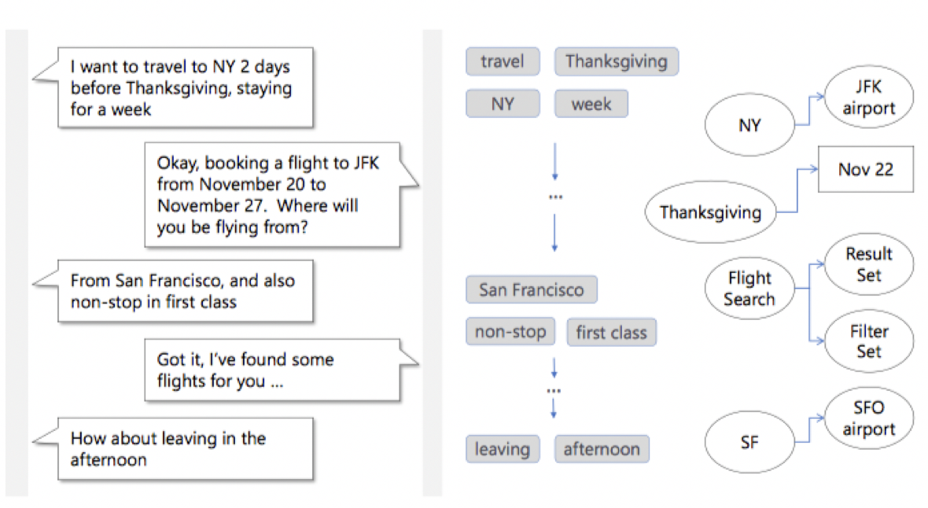
Application: Conversation
Knowledge-powered Conversation

Slide 13
How to Construct a Knowledge Graph?

Slide 14
What does knowledge come from?
Manually curated
Mapping from semi-structured data
From unstructured data
natural language and images

Slide 15
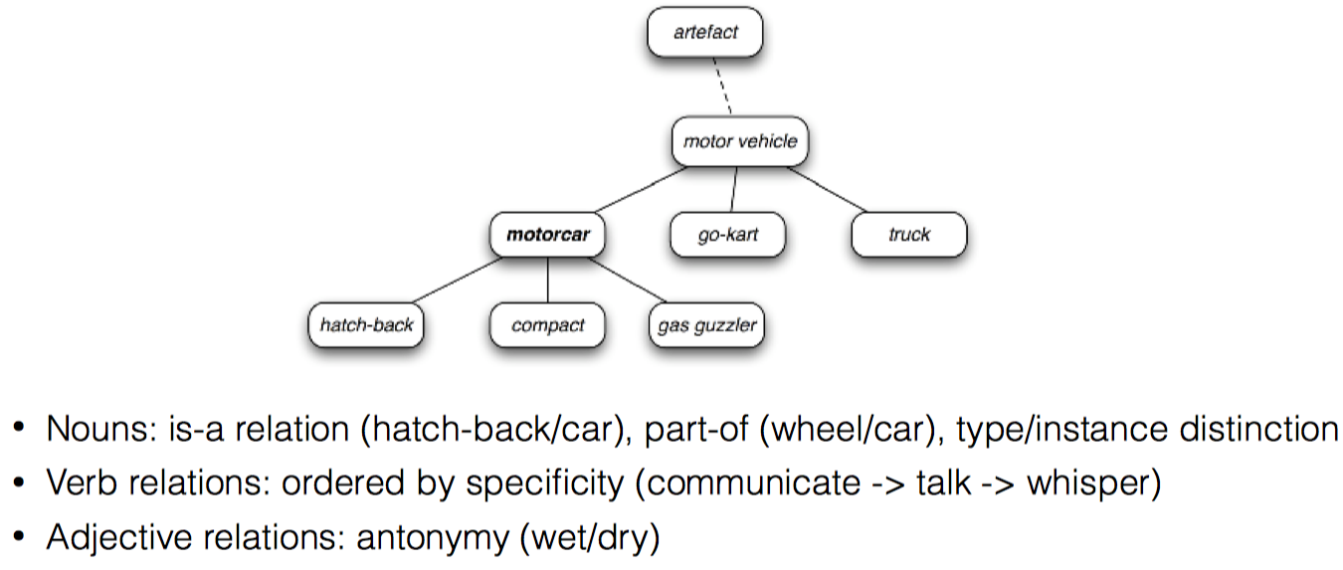
WordNet [Miller 1995]
A large database of words including parts of speech, semantic relations

Slide 16
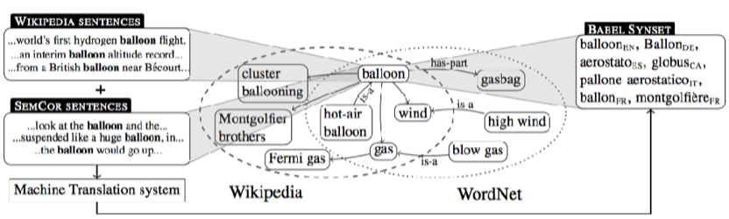
BabelNet [Navigli and Ponzetto 2008]
meta-database including various sources such as WordNet and Wikipedia, but augmented with multi-lingual information
11M images

Slide 17
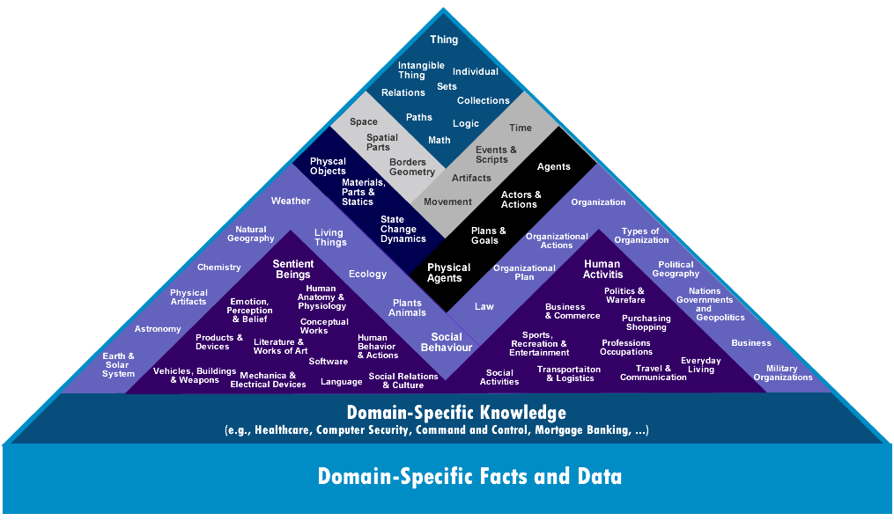
Cyc [Lenant 1995]
A manually curated database attempting to encode all common sense knowledge, 30 years in the making

Slide 18
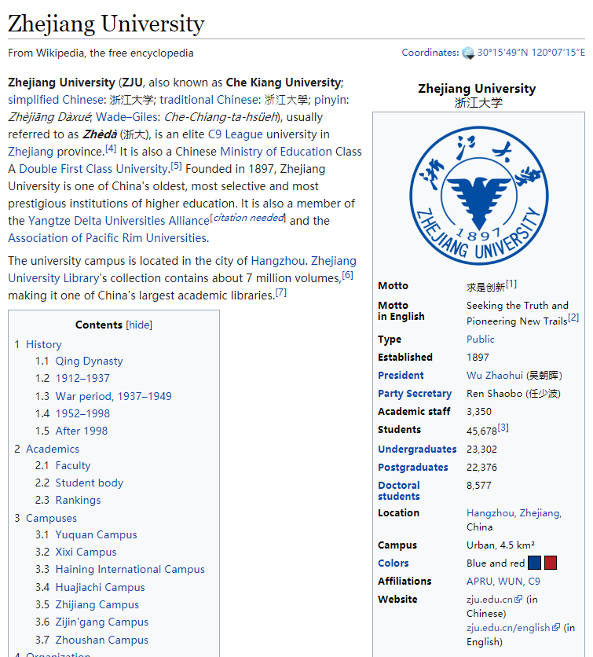
DBPedia [Auer et al. 2007]
Extraction of semi-structured data from Wikipedia
Infobox

Slide 19
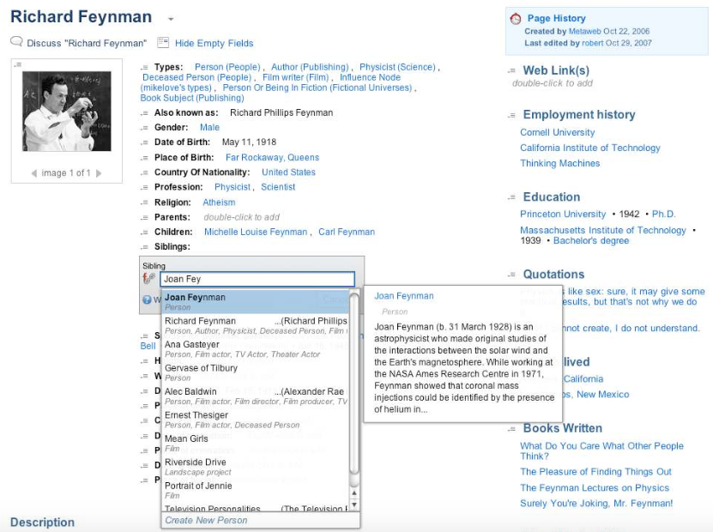
Freebase [Bollacker et al. 2008]
Curated database of entities, linked, and extremely large scale

Slide 20
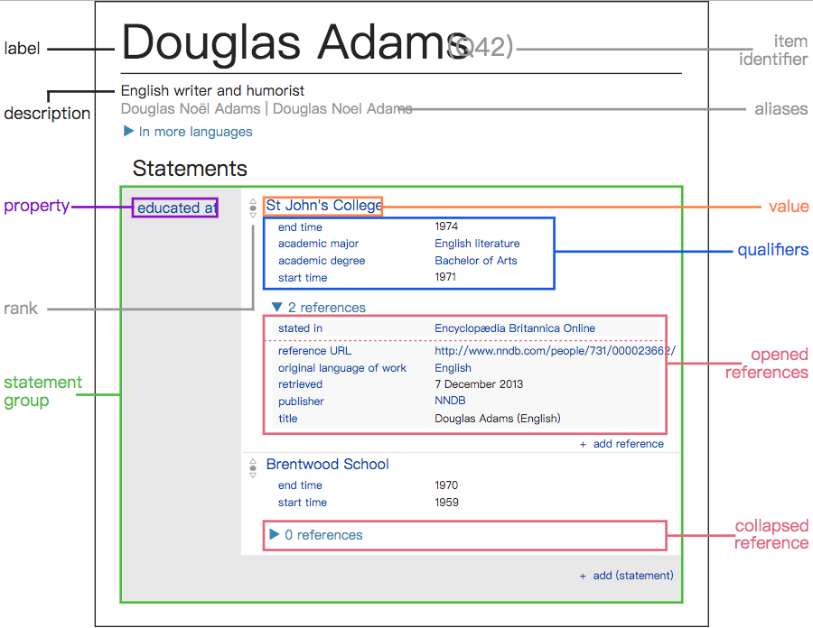
WikiData [Vrandečić and Krötzsch 2014]
Knowledge base run by WikiMedia foundation and successor to FreeBase
Incorporates many of the good points of previous work: multilingual, automatically extracted + curated, SPARQL interface

Slide 21




What does knowledge come from?
From the unstructured world to the structured world
Accident Reports
(Insurance companies)
Law Case Files (Law firms)
Structured Data
(Machine can read and utilize)
Clinical Report (Hospitals)
Patent (Tech Companies)
Unstructured Documents
(Human can read and utilize)

Slide 22
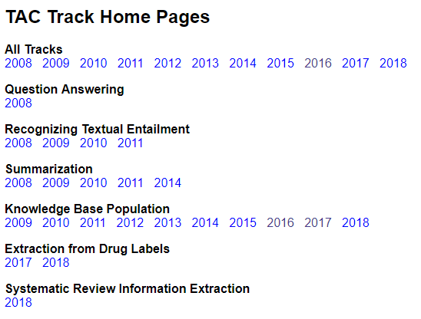
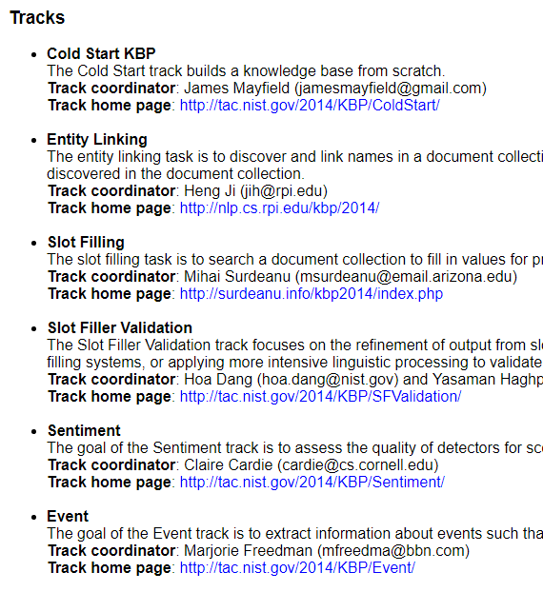
NIST Text Analysis Conference KBP
TAC is organized by the Retrieval Group of the Information Access Division (IAD) in the Information Technology Laboratory at the National Institute of Standards and Technology (NIST). Initiated in 2008

Slide 23
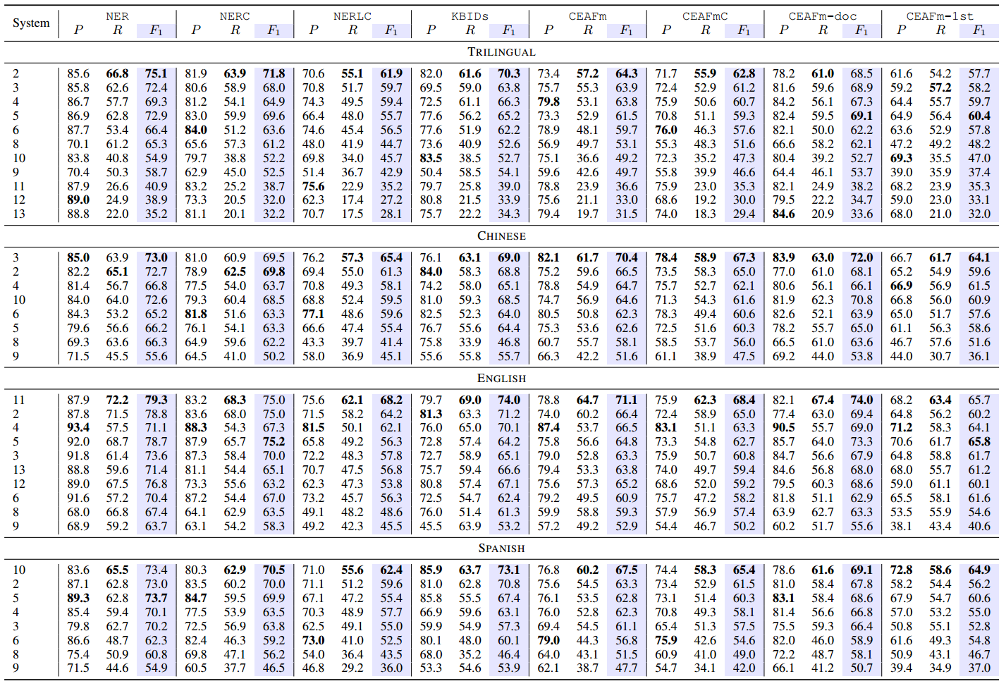
NIST Text Analysis Conference KBP
2016 年获得TAC KBP 英文实体检测、链接竞赛综合排名第一
实体检测任务（Mention Detection）
3个指标中2项第一，1项并列第二
实体链接任务（Entity Linking）
5个指标中4项第一，1项第二
参赛队伍包括CMU、UIUC 、 IBM、UCL 、讯飞、北邮等国内外相关领域知名高校与研究机构
Notes:
带领团队连续参加最具影响力的国际知识库构建大赛（NIST TAC），2016 年获得TAC KBP 英文实体检测、链接竞赛综合排名第一

Slide 24
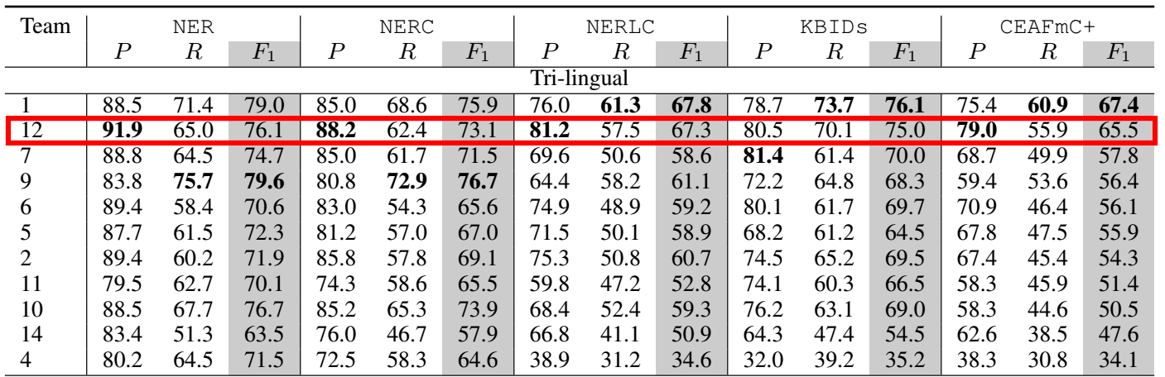
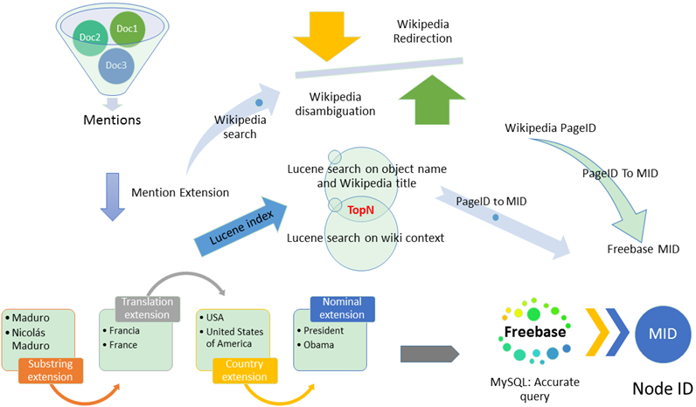
NIST Text Analysis Conference KBP
2017 年获得TAC KBP 中文、英文、西班牙文三种语言实体识别与链接任务准确度第一、综合第二名
参赛队伍包括CMU, York, RPI, UIUC, Stanford, Columbia, Cornell, Johns Hopkins, University of Pennsylvania, UCL, USC等国外知名高校；腾讯AI、IBM、Ricoh Software、阿里巴巴、搜狗等国内外公司；北邮、国防科大、中科院计算所、软件所等国内高校
参赛系统
Notes:
2017 年获得TAC KBP 中文、英文、西班牙文三种语言实体识别与链接任务准确度第一、综合第二名

Slide 25
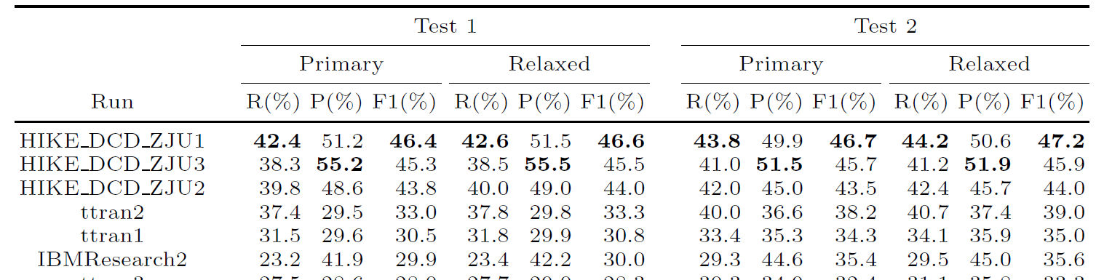
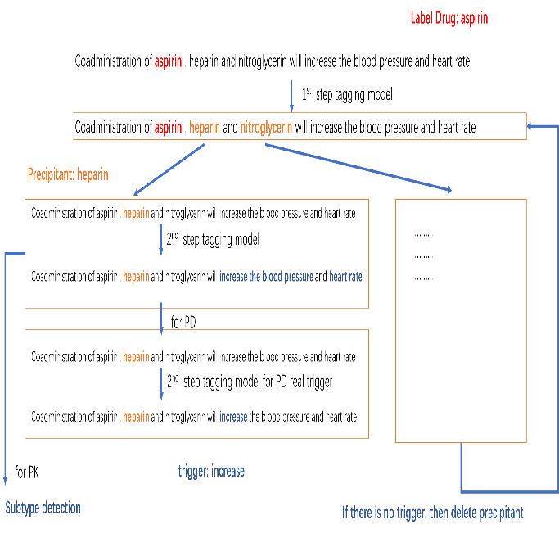
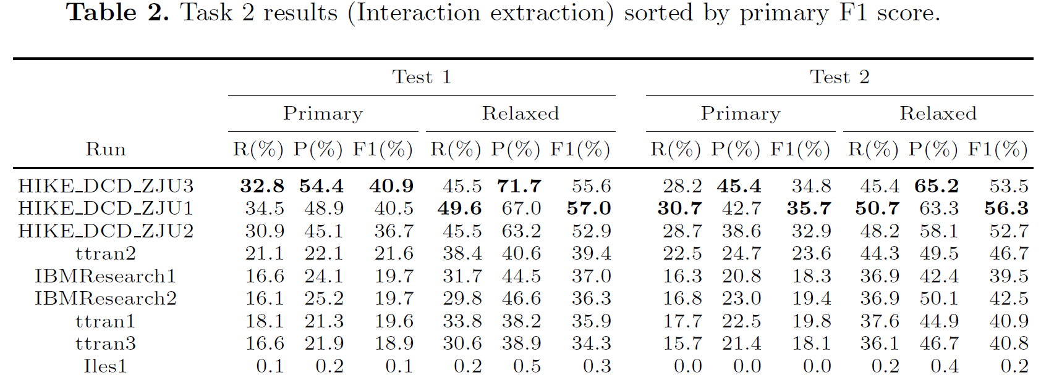
NIST Text Analysis Conference KBP
2018年参加TAC DDI（药物作用关系抽取竞赛），在所参加的两项任务中均取得第一名
任务1
任务2
参赛者包括美国国家医学图书馆、IBM研究院、北京大学、北邮等国内外研究机构
Notes:
2018年参加TAC DDI（药物作用关系抽取竞赛），在所参加的两项任务中均取得第一名。这显示我国自动化知识图谱构建技术处于国际领先水平。

Slide 26

KG construction from Unstructured Data
Human in the loop
1. Mention Detection
4. Relation Extraction
3. Entity Typing (Fine-grained)
2. Mention Disambiguation

Slide 27
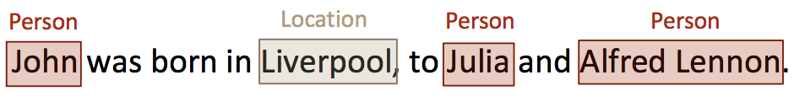
1. Mention Detection
Named Entity Recognition (NER) is the task of identifying named entities like person, location, organization,drug, time, clinical procedure, biological protein, etc. in text.
Rule-based & lexicon-based method
Unsupervised and bootstrapped method
Feature-engineered supervised method
Deep learning for NER

Slide 28
1. Mention Detection
Rule-based & lexicon-based method
Do not require annotated training data
Rely on lexicon resource and domain specific knowledge, e.g.
DrugNER dataset [Bedmar et al., 2013]
DrugBank dictionaries [Knox et al., 2010]
High Precision, low recall
Unsupervised and bootstrapped method
Key idea: lexical resources, lexical patterns, and statistics computed on a large corpus can be used to infer mentions of named entities.
Collins et al. (1999) observed that use of unlabeled data reduces the requirements for supervision to just 7 simple “seed” rules.
Zhang and Elhadad (2013) used shallow syntactic knowledge and inverse document frequency (IDF) for an unsupervised NER system

Slide 29
1. Mention Detection
Feature-engineered supervised method
Regard NER as a multi-class classification or sequence labeling task
Feature engineering is critical
Word-level features (e.g., case, morphology, and part-of-speech tag), list lookup features (e.g., Wikipedia gazetteer and Dbpedia gazetteer), and document and corpus features (e.g., local syntax and multiple occurrences) have been widely used in various supervised NER systems.
Hidden Markov Models (HMM), Support Vector Machines (SVM), Conditional Random Fields (CRF), and decision trees were common machine learning systems for NER.

Slide 30
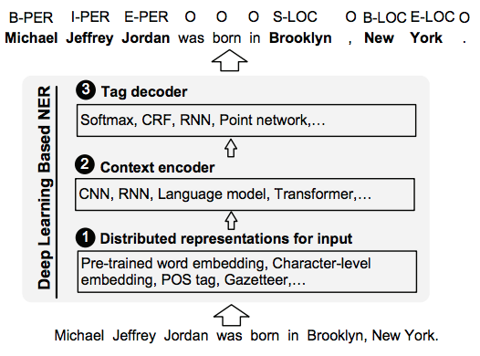
Deep learning for NER
Regard NER as a multi-class classification or sequence labeling task
hand-crafted features → discovering hidden features automatically

Slide 31
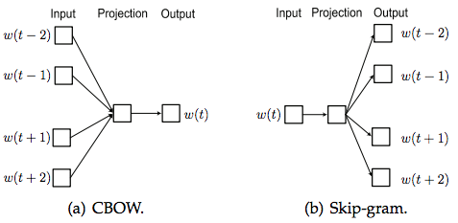
Named Entity Recognition
Distributed Representations for Input
Word-level representation: pre-trained word embedding (e.g. word2vec, Glove)

Slide 32
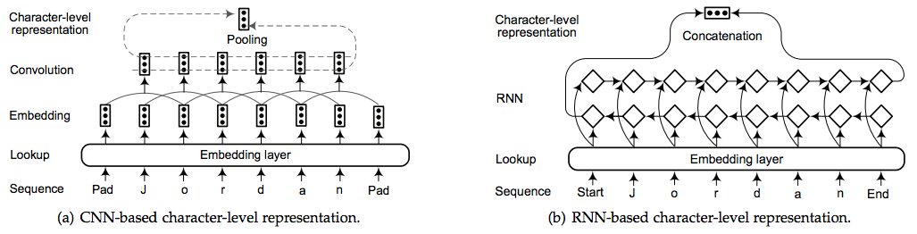
Named Entity Recognition
Distributed Representations for Input
Character-level representation: explicit sub-word-level information such as prefix and suffix

Slide 33
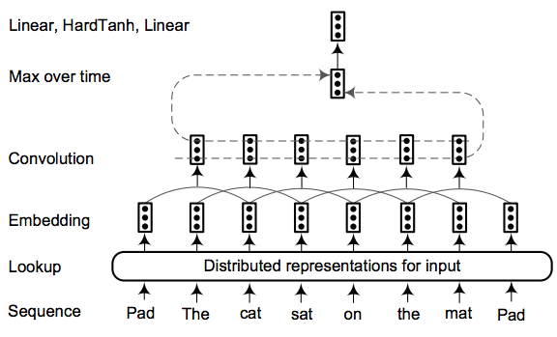
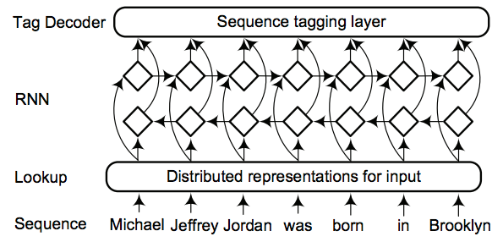
Named Entity Recognition
Context Encoder
Convolutional Neural Networks
Recurrent Neural Networks

Slide 34
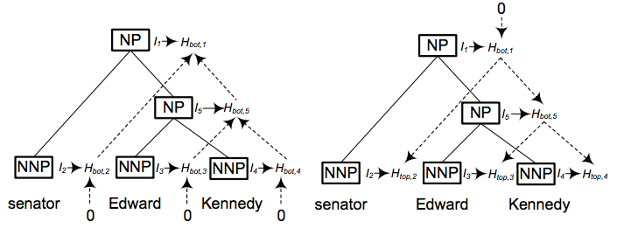
Named Entity Recognition
Context Encoder (cont.)
Recursive neural networks

Slide 35
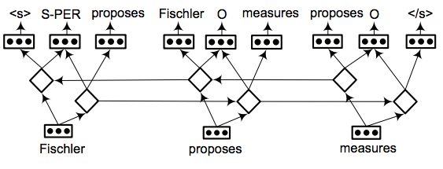
Named Entity Recognition
Context Encoder (cont.)
Neural Language Models
At each time step, predict the previous token, current tag, and the next token in the sequence
The added language modeling objective encourages the system to learn richer feature representations which are then reused for NER
Neural Language Models

Slide 36
Multi-task Learning
Joint Model Named Entity Recognition and Learning Word Representations
Linear Chain CRF for NER
y₁
y₂
…
y_{n}
Language
model
c₁
c₂
c₄
c₅
…
Lexical
Features
…
m
…
…
…
Embeddings Lookup Table
_{C}(1)
……
_{C}(n-1)
_{C}(n)
…
…
…
d
…
Sharing parameters
Feature Extractor
Input C⁽¹⁾
for NER
……
_{C}(n-1)
_{C}(n)
Unlabeled C⁽¹⁾
input data
……
_{C}(n-1)
_{C}(n)
Peng and Dredze, 2015

Slide 37


Multi-task Learning
Joint Model Named Entity Recognition and Word Segmentation
Linear Chain CRF for CWS
y₁
y₂
…
y_{n}
Linear Chain CRF for NER
y₁
y₂
…
y_{n}
Hidden Layer ……
…
…
…
k
…
Lexical
Features
…
LSTM for Segmentation
…
…
…
m
…
_{C}(1)
_{C}(n-1)
_{C}(n)
Sharing parameters
Embeddings Lookup Table
……
Feature Extractor
…
…
…
d
…
Input C⁽¹⁾
For CWS
……
_{C}(n-1)
_{C}(n)
Input for NER
_{C}(1)
……
_{C}(n-1)
_{C}(n)
Peng and Dredze, 2016

Slide 38
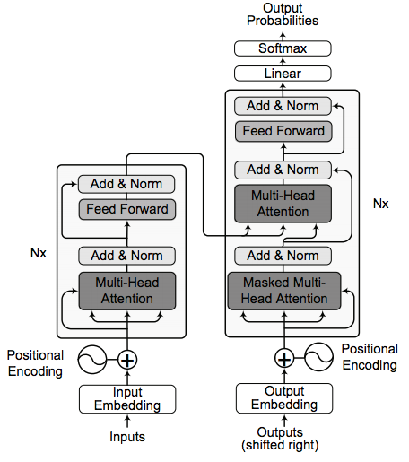

Named Entity Recognition
Context Encoder (cont.)
Deep Transformer
Stacked self-attention and point-wise, fully connected layers to build basic blocks for encoder and decoder
Deep Transformer

Slide 39
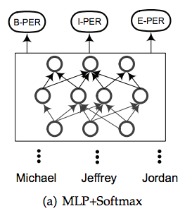
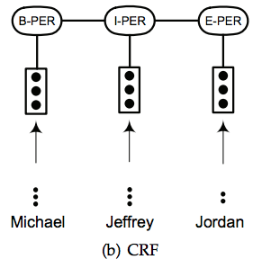
Named Entity Recognition
Tag Decoder
Multi-Layer Perceptron + Softmax
Conditional Random Fields
(Globally conditioned on the observation sequence)

Slide 40
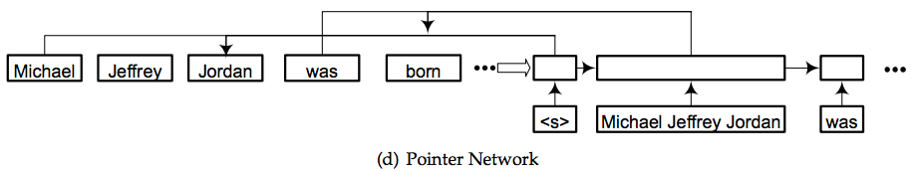
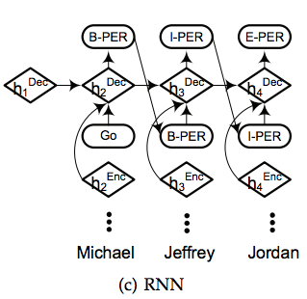
Named Entity Recognition
Tag Decoder (cont.)
Pointer Network
Recurrent Neural Networks

Slide 41
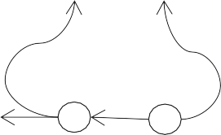
Multi-task Multi-domain Learning
…
y₁
Task Specific Models
Decoder for Task one
y_{n}
……
Decoders for
task T
Domain Projections
Projection for
……
Projection for domain N
domain one
Hidden Layer
…
…
…
…
…
k
Shared Representation
BiLSTM
…
…
Learner
Embeddings Lookup Table
_{C}(1) _{C}(n-1) _{C}(n)
……
…
…
…
d
…
Input data
_{w}(1)
……
_{w}(n-1)
_{w}(n)
Peng and Dredze, 2017

Slide 42
Knowledge Distillation
NITE (a Neural Inductive TEaching framework)
针对特定领域训练数据匮乏的问题。向领域中已有的，并已经训练好的模型进行学习，将这些模型的领域知识迁移到一个新的任意架构的深度模型上。
针对迁移过程中带入的错误，利用多实例学习进行噪音的抑制。
少量人工标注数据
任意深度神经网络
多实例学习
KL
Knowledge Distillation
大量未标注数据
已有的浅层模型
（well trained shallow model）
NITE (a Neural Inductive TEaching framework)

Slide 43
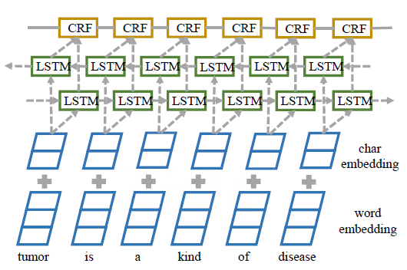
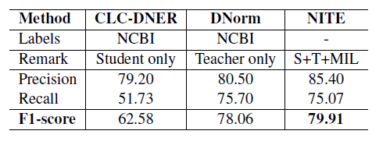
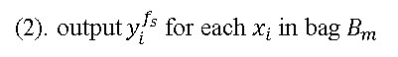
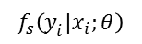
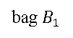
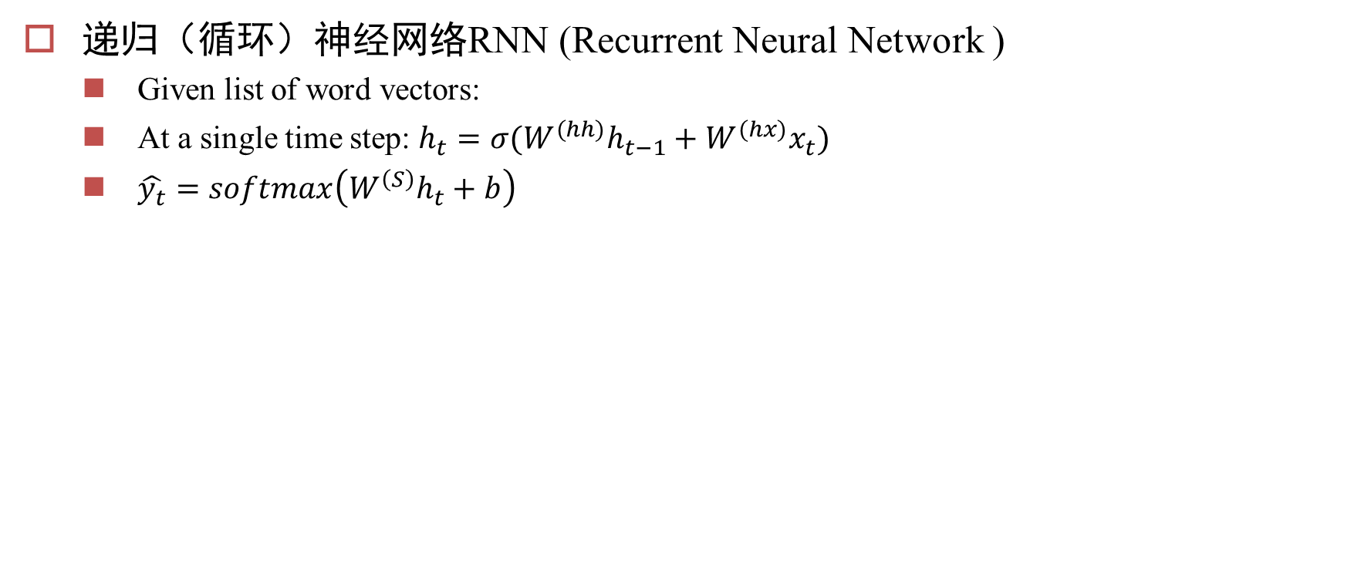
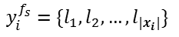
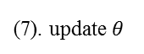
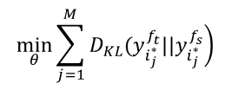
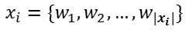
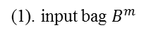
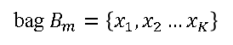
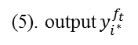



Knowledge Distillation
可有效提升特定专业领域的实体识别性能 30%
(5). output $y_{i_{}^{∗}}^{f_{s}}$
KL
MIL
(6). minimize KL
(3). f$ind$ $y_{i_{}^{∗}}^{f_{s}}=\underset{i=1:K}{arg max}{P\left(y_{i}^{f_{s}}|x_{i}\right)}$
$$\min_{θ}\sum_{j=1}^{M}{\left.D_{KL}(y_{i_{j}^{∗}}^{f_{t}}||y_{i_{j}^{∗}}^{f_{s}}\right)}$$
$$y_{i}^{f_{s}}=\{l_{1},l_{2},…,l_{|x_{i}|}\}$$
(5). output $y_{i_{}^{∗}}^{f_{t}}$
(2). output $y_{i}^{f_{s}}$ for each $x_{i}$ in bag $B_{m}$
Teacher
(7). update$θ$
Student Network
$$f_{t}\left(y_{i}^{}|x_{i}\right)$$
$$f_{s}\left(y_{i}^{}|x_{i};θ\right)$$
(1). input bag $B^{m}$
…
…
$$x_{i}=\{w_{1},w_{2},…,w_{|x_{i}|}\}$$
bag $B_{1}$
bag $B_{m}=\left\{x_{1},x_{2}…x_{K}\right\}$
bag $B_{M}$

Slide 44
KG construction from Unstructured Data
Human in the loop
1. Mention Detection
4. Relation Extraction
3. Entity Typing (Fine-grained)
2. Mention Disambiguation

Slide 45

2. Mention Disambiguation
Dealing with Ambiguity of Natural Language
Mentions of entities and concepts could have multiple meanings
Dealing with Variability of Natural Language
A given concept could be expressed in many ways

Slide 46



2. Mention Disambiguation
Tri-lingual (English, Chinese and Spanish) Entity Discovery and Linking
Source Collection
13岁以前的杨丽萍，是云南一个山村小镇里光着脚丫到处拾麦穗的乡下小姑娘，在洱海之源过着艰苦而又不无乐趣的童年生活。
Now, Ms. Yang, one of China's best-known dancers, is the director of …
Aunque nacida en Dali, a la edad de nueve años Yang se mudó con su familia a Xishuangbanna. Debido a su extraordinario talento, la eligieron para integrar la Agrupación Artística de Canto …
…
KB
Liping Yang
Liping Yang

另外，对于链不到知识库中的mention进行聚类

Slide 47




Entity Linking
The task consists of:
A definition of the mentions (concepts, entities) to highlight
A mention: a phrase used to refer to something in the world
Named entity (person, organization, place), object, substance, event, philosophy, mental state, rule …
Determining the target encyclopedic resource (KB)
Defining what to point to in the KB (title)
NIL Clustering
cluster relevant mentions representing a single concept or entity

Slide 48
Entity Linking
A General Architecture
Input: A text document d; Output: a set of pairs (m_{i} ,t_{i})
m_{i} are mentions in d; t_{j}(m_{i} ) are corresponding Wikipedia titles, or NIL id.
(a) Identify Mentions m_{i} in d
(b) Identify a set of relevant titles T(mi )
(d) Local Inference
For each m_{i} in d:
Rank titles t_{i} ∈ T(m_{i} )
[E.g., consider local statistics of edges [(m_{i} ,t_{i}) , (m_{i} ,*), and (*, t_{i} )] occurrences in the Wikipedia graph]
(d) Global Inference
For each document d:
Consider all m_{i} ∈ d; and all t_{i} ∈ T(m_{i} )
Re-rank titles t_{i} ∈ T(m_{i} )
[E.g., if m, m’ are related by virtue of being in d, their corresponding titles t, t’ may also be related]
(e) NIL Clustering
decide NIL Links and cluster relevant mentions

Slide 49
a. Identify Mentions
every n-gram is a potential concept mention
Intractable for larger documents
Surface form based filtering
Shallow parsing (especially NP chunks), NP’s augmented with surrounding tokens, capitalized words
Remove: single characters, “stop words”, punctuation, etc.
Statistics based filtering
Name tagging (Finkel et al., 2005; Ratinov and Roth, 2009; Li et al., 2012)
Mention extraction (Florian et al., 2006, Li and Ji, 2014)
Key phrase extraction, independence tests (Mihalcea and Csomai, 2007), common word removal (Mendes et al., 2012; )
Mention Expansion
Optional post-processing
Co-reference resolution, Known Aliases, Acronym

Slide 50


b. Generating Candidate Titles
Named Dictionary Based
The main approach
Dictionary D is constructed by leveraging features from Wikipedia or data mining
Entity pages, Redirect pages, Disambiguation pages, Bold phrases from the first paragraphs, hyperlinks in Wikipedia articles
Looking up methods:
Exact matching, Super or substring of the mention, String similarity
Search Engine based
Effective at identifying some very difficult mapping
Morph (Chris Christie, Jabba the Hutt), Acronym (CCP, Communist Party of China)

Slide 51
实体链接任务
常见通用实体链接目标知识库
常用的实体链接策略
实体的热度：mention所对应潜在实体列表中实体的热度（popularity/commonness）
上下文相似性：mention所在上下文与知识库中对于entity的描述之间的相似性
主题相关性：同一个文档或者段落中出现的实体，往往会共享相同的主题
Name | Source | # types | # entities | Hierarchy
Dbpedia | Wikipedia infoboxes | 529 | 3M | Tree
YAGO2s | Wiki, WordNet, | 350K | 10M | Tree
Freebase | Miscellaneous | 23K | 23M | Flat
Probase | Web text | 2M | 5M | DAG

Slide 52






实体链接算法
文档向量作为实体链接的主要依据之一，对于实体链接的性能有着重要的影响，目前主流的文档向量学习方法普遍没有考虑实体链接的需要，即在学习文档向量的过程中，将文本中的实体与其它单词统一对待，不做区分。
上下文感知的文档向量学习
对文档(文本段)$d$中词的分布建模：$P_{d}(w|θ^{dw})$，去近似实际的分布： $P_{d}^{∗}(w)$
同样，对文档$d$中提及实体的分布建模：$Q_{d}(e|θ^{de})$；对与实体$e$共同出现的实体的分布建模： $R_{e}(e′|θ^{ee})$
$$P_{d}(w|θ^{dw})=\frac{\exp\left(v_{d}^{T} v_{w}\right)}{\sum_{w′}{exp⁡(v_{d}^{T}v_{w^{′}})}}$$
$θ^{dw}:\{v_{d},v_{w}\}$; $θ^{de}:\{v_{d},v_{e}^{′}\}$; $θ^{ee}:\{v_{e},v_{e}^{′}\}$
$$J=λ_{1}\sum_{d}{|W_{d}|H(P_{d}^{∗},P_{d})}+λ_{2}\sum_{d}{{|E}_{d}|H\left(Q_{d}^{∗},Q_{d}\right)}+λ_{3}\sum_{e}{{|E}_{e}|H\left(R_{e}^{∗},R_{e}\right)}+γ⋅{\left\|Ω\right\|}_{2}^{2}$$
s.t. $λ_{1}+λ_{2}+λ_{3}=1$
$\left|W_{d}\right|$: 文档（文本段）$d$中的总词数

Slide 53




实体链接算法
将学习得到的文档向量用于文本聚类与分类
文本聚类上的结果
文本分类上的结果

Slide 54


实体链接算法
将学习得到的文档向量用于实体链接，是目前在TAC-KBP数据集上最好的实体链接系统。

Slide 55

基于RL与动态上下文增强的实体链接系统（1）
在实体链接消歧过程中，动态计算的上下文相似度是实体消除歧义的重要依据。但在上下文不丰富（短文本）的情况下，该信息往往不能有效利用。
针对上述问题，我们提出了DCA-RL (Dynamic Context Augmentation - Reinforcement Learning) 框架
DCA-RL

Slide 56


基于RL与动态上下文增强的实体链接系统（2）
DCA-RL框架
Agent模型

Slide 57




基于RL与动态上下文增强的实体链接系统（3）
Reward设计
$R_{T}=−\left({\left|𝕄_{e}\right|}/T\right)$
$𝕄_{e}$: 链接错误的实体提及数量
$T$: 实体提及总数
$γ$: 折扣率
实验结果

Slide 58

基于RL与动态上下文增强的实体链接系统（4）
在多个跨领域数据集的实验结果

Slide 59
KG construction from Unstructured Data
Human in the loop
1. Mention Detection
4. Relation Extraction
3. Entity Typing (Fine-grained)
2. Mention Disambiguation

Slide 60

超细粒度实体识别（背景）
重点研究从英文文本中识别超细分类命名实体（7000类），再将其链接到Freebase知识库的算法，并提供了相应的算法说明与使用文档，以及API服务。
任务描述
地点
人名
机构名
地理位置
粗粒度类型实体
设施名
Yago-7000+类（层次化细粒度）

Slide 61

超细粒度实体识别（难点）
难点：类型多，粒度细，有层次，没有训练数据。
基本思路：
由于需要识别的实体类型数量变多，因此考虑先定位，再识别与链接的技术路线。
基于7大类别训练localizer
Typing与linking联合
Mention Types
Typing
Text Mention Localization
Raw Text
NIL Clustering
Linking
Entity ID in KB

Slide 62

细粒度实体类别标注工具（1）
设计并实现基于Tkinter的细粒度实体类别标注工具，对链接后的实体进行类别的标注，具有以下特点：
提供层级的细粒度类型树展示
提供实体候选展示，对链接结果进行修正
显示类别定义、实体在维基页面的首段描述
类型树展示
实体候选展示

Slide 63

零样本细粒度实体分类（1）
针对超细粒度实体分类中标注缺失的问题，我们提出了基于零样本学习的实体超细粒度分类算法：Neural Zero-shot Fine-Grained Entity Typing (NZFET)
使用entity type的attention，使得模型对有噪音的训练数据更具鲁棒性。
使用LSTM和entity type与context的attention来得到与实体类型相关的上下文表达，这样能使模型对上下文中无关内容更鲁棒。再结合mention的表达，通过score function得到mention和entity type的相关性分数。

Slide 64

零样本细粒度实体分类（2）
实验结果
NZFET在三个数据集上均高于Ma et al.。体现了模型相比于手工特征模型的优越。
NZFET在有噪音的数据集OntoNotes和Wiki数据集上均超过变体AE，在无噪音的数据集BBN上，和变体AE的结果近似。在噪音更多的OntoNotes数据集上，NZFET超过state of the art 35%，在噪音较少的Wiki数据集上超过state-of-the-art 21%。体现了模型对噪音的鲁棒性。
AE是我们模型更换了attention机制后的变体，作为对照试验。Ma et al.是当前the state-of-the-art

Slide 65
半监督细粒度实体分类算法（1）
针对超细粒度实体分类任务中数据噪声比较大的问题，我们进一步研究了基于紧致隐空间聚类的半监督超细粒度实体分类算法CCLP
细粒度实体分类由于标注成本较高，数据大多来自远程监督
远程监督：对句子中的提及m进行实体链接，将m对应的知识库中实体e的类型全部标记为该提及的类型
远程监督带来了标注数据的标签噪声问题：知识库的类型不一定与提及上下文相匹配。比如奥巴马在竞选中获胜，并不能指出奥巴马是一个大学毕业生。
传统方法主要通过后验概率最大化的方法对噪声数据进行处理
我们借鉴了半监督学习中压缩特征空间簇的方法来借助噪声数据提高模型性能

Slide 66

半监督细粒度实体分类算法（2）
新算法用 NFETC（Neural Fine-grained Entity Type Classification with Hierarchy-Aware Loss）作为特征抽取部分。基于Semi-Supervised Learning via Compact Latent Space Clustering算法，使用低质量的多标签数据在特征隐空间加入约束，使用高质量的单标签的数据训练分类器
在特征隐空间中建图，加入压缩特征空间聚类的方法，使得标签相关度高的样本特征也相近，标签相关度低的样本特征相远离

Slide 67
半监督细粒度实体分类算法（3）
实验结果
NFETC-CCLP在两个数据集上均超过state-of-the-art 。体现了压缩特征空间簇方法相比较传统降噪方法（后验概率最大化）的优势。
NFETC-CCLP在噪音增大的情况下，相对于传统降噪方法有极大优势。
仅需要1/3的数据在BBN上就可以达到与state-of-the-art 可比较的结果
 | Ontonote |  |  | BBN
 | Strict Acc. | Macro F1 | Micro F1 | Strict Acc. | Macro F1 | Micro F1
NFETC (F) | 0.544±0.003 | 0.715±0.004 | 0.649±0.003 | 0.717(±0.004) | 0.778(±0.004) | 0.775(±0.004)
NFETC (R) | 0.548±0.004 | 0.718±0.004 | 0.650±0.004 | 0.738(±0.006) | 0.784(±0.006) | 0.789(±0.006)
NFETC-CCLP | 0.594(±0.008) | 0.756(±0.007) | 0.694(±0.007) | 0.741(±0.003) | 0.800(±0.002) | 0.797(±0.002)
NFETC-5% (r) | 0.420(+0.007) | 0.591(+0.008) | 0.520(+0.006) | 0.626(±0.028) | 0.669(±0.027) | 0.681(±0.028)
NFETC-CCLP-5%(r) | 0.498(±0.004) | 0.680(±0.004) | 0.618(±0.004) | 0.702(±0.006) | 0.747(±0.007) | 0.749(±0.006)
F 为仅用高质量数据训练
R 为用全部数据训练
Accepted by NAACL 2019

Slide 68
KG construction from Unstructured Data
Human in the loop
1. Mention Detection
4. Relation Extraction
3. Entity Typing (Fine-grained)
2. Mention Disambiguation

Slide 69
Learning from Text Directly

Slide 70

Distant Supervision for Relation Extraction
Given an entity-relation-entity triple, extract all text that matches this and use it to train
Creates a large corpus of (noisily) labeled text to train a system
(Mintz et al. 2009)

Slide 71
DS-RE (Slot-filling)
任务内容
基于实体发现与链接的结果，对于未出现在知识库中的实体词条，从专业的非结构化文本文档中检测该实体的各类预先定义好的属性。
本质上是一个句子分类问题。
基本思路：远程监督
如果一个句子中的两个实体存在某种关系，那么这个句子就以某种方式表示这种关系。
例子：
奥巴马1961年出生于美国夏威夷州火奴鲁鲁。
实体：奥巴马 —— 属性：出生地 —— 值：美国
奥巴马出生于美国夏威夷州火奴鲁鲁
姚明出生于中国上海
假设
两个句子都有出生地的关系，句子有类似的结构；
如果新的一个句子有类似的结构，那么，这个句子中的实体也有这种关系。

Slide 72
DS-RE (Slot-filling)
远程监督方法
输入数据
实体对
包含实体对和关系的语料库
模型
生成句子级的训练样本
正样本：包含实体对中两个实体的句子
负样本：包含一个实体，另一个实体类型的词
存在问题
远程监督模型假设过强，训练样本噪声大
使用传统方法时，手工构造特征复杂费时

Slide 73
A Slot-filling System
结合规则与远程监督的属性填充系统
文本预处理
语料库
知识库
关键字检索
Elastic Search
远程监督模型
CNN
抽取结果
模式匹配

Slide 74

CNNs (Zeng et al. 2014)
Extract features w/o syntax using CNN
Lexical features of the words themselves
Features of the whole span extracted using convolution

Slide 75

Piecewise CNN^{[1]}
Piecewise CNN特征提取 + Softmax分类器
传统Text CNN在sentences level分类上取得了非常好的效果
根据slot filling特点，根据实体位置，分段池化，获得句子内的结构化信息
1. Zeng, Daojian, et al. "Distant supervision for relation extraction via piecewise convolutional neural networks." Proceedings of the 2015 Conference on Empirical Methods in Natural Language Processing (EMNLP), Lisbon, Portugal. 2015.

Slide 76


Jointly Modeling KB Relations and Text
To model textual links between words w/ neural net: aggregate over multiple instances of links in dependency tree
Model relations w/ CNN
(Toutanova et al. 2015)

Slide 77

跨关系跨包双层注意力的属性填充（1）
在文本关系抽取问题上，设计并实现了新的算法C²SA ，进一步提升了通用文本关系抽取模型的性能。
新算法针对远程监督+多实例学习的基本假设中存在一些问题，提出了两种新的注意力机制。
跨关系注意力：解决了目前远程监督没有考虑关系之间的关系的问题。即，生成的样本可能有多个标签，这些标签之间存在互斥、与包含的关系。
跨多实例包注意力：解决了多实例学习中假设一个正包中包含至少一个被远程监督正确标注的样本不满足情况下带来的错误。
Cross-relation Cross-bag Attention for Distantly-supervised Relation Extraction. Yujin Yuan, Liyuan Liu, Siliang Tang, Zhongfei Zhang, Yueting Zhuang, Fei Wu, Xiang Ren. AAAI 2019

Slide 78


跨关系跨包双层注意力的属性填充（2）
跨关系注意力
跨多实例包注意力
Cross-relation Cross-bag Attention for Distantly-supervised Relation Extraction. Yujin Yuan, Liyuan Liu, Siliang Tang, Zhongfei Zhang, Yueting Zhuang, Fei Wu, Xiang Ren. AAAI 2019

Slide 79


跨关系跨包双层注意力的属性填充（3）
平均提升13%，最高提升22%
实验结果
Cross-relation Cross-bag Attention for Distantly-supervised Relation Extraction. Yujin Yuan, Liyuan Liu, Siliang Tang, Zhongfei Zhang, Yueting Zhuang, Fei Wu, Xiang Ren. AAAI 2019

Slide 80

Modeling DS Noise in Neural Models
Idea: there is noise in distant supervision labels, so we want to model it
By controlling the “transition matrix”, we can adjust to the amount of noise expected in the data
Trace normalization to try to make matrix close to identity
Start training w/ no transition matrix on data expected to be clean, then phase in on full data
(Luo et al. 2017)

Slide 81



ENCORE
传统的远程监督算法没有考虑数据的来源与确信度
在实际情况下，训练数据可以来自于：
人
算法
规则
人工标注的数据
主动学习算法标注的数据
远程监督生成的数据
质量最好
质量由确信度来表示
质量最差

Slide 82


ENCORE
如何在深度学习框架下引入数据来源与确信度，更好的进行人机协同的学习，来提升属性填充算法性能是一个值得研究的问题
算法3：ENCORE: External Neural Constraints Regularized Distant Supervision
将三种不同来源的数据用不同的神经网络来进行处理（施加不同的后验概率正则化约束项），最后将这些信息通过多实例学习进行融合。
后验概率
基于多实例学习的
模型融合框架
后验概率
Teacher
Network
后验概率
损失
Teacher
Network
确信度
神经网络
共享
参数
深度卷积
神经网络
（Student）
共享
参数
标注数据
约束网络
在未增加任何新标注数据的情况下，ENCORE 约束后的神经网络，性能提升了12%
机器学习算法
标注的训练数据
远程监督
生成的训练数据
人工标注的
训练数据

Slide 83


特定领域关系抽取——药物作用关系抽取
TAC 2018 （第十届）由美国国家标准技术研究所（NIST）举办，美国国防部 （DOD）与美国国家卫生研究所（NIH）共同出资。
药物作用关系抽取竞赛（ DDI）是TAC 2018的四个Track之一，其主要任务将FDA（食品及药物管理局）与NLM（美国国家医学图书馆）定义的非结构化药物标签文档（SPL）转换为计算机可读的结构化数据，揭示其中药物与药物之间的相互影响关系（药物代谢动力学，药效动力学等关系）。

Slide 84
药物作用关系抽取系统（2）
任务1：给定标签药物，抽取药物/成分，药物交互关系触发词，以及描述特定交互区域。
任务2：给出交互的药物类型，与特定交互类型（3类），并给出其对应的交互FDA编码（ 20类）
标签药物
与标签药物交互的药物/成分
Coadministration of aspirin , heparin and nitroglycerin will increase the blood pressure and heart rate
关系触发词
描述特定交互区域
输入：aspirin increased nitroglycerin
输出
Interaction type: Pharmacokinetic
subtype: INCREASED DRUG LEVEL

Slide 85

药物作用关系抽取系统（3）
针对任务1与任务2的关联性，我们基于扩展的BIO-HD标注模型（CNN+BiGRU）设计了Two-Step Joint System来联合求解任务1与任务2。
HIKE_DCD_ZJU系统处理流程示意图

Slide 86

药物作用关系抽取系统（4）
BIO-HD标注模式
E.g., increase the blood pressure and heart rate
SI1: increase the blood pressure
SI2: increase … heart rate

Slide 87

药物作用关系抽取系统（5）
序列标注模型
LSTM
LSTM + CRF
CNN-based encoder [ Conv * 3 ] + RNN-based decoder [ bidirectional GRU ]

Slide 88

药物作用关系抽取系统（6）
基于规则的子类型检测系统

Slide 89
Schema-Free Extraction (OpenIE)

Slide 90
Open Information Extraction
Basic idea: the text is the relation
e.g. "United has a hub in Chicago, which is the headquarters of United Continental Holdings"
{United; has a hub in; Chicago}
{Chicago; is the headquarters of; United Continental Holdings}
Can extract any variety of relations, but does not abstract
(Banko et al 2007)

Slide 91
Rule-based Open IE
e.g. TextRunner (Banko et al. 2007), ReVerb (Fader et al. 2011)
Use parser to extract according to rules
e.g. relation must contain a predicate, subject object must be noun phrases, etc.
Train a fast model to extract over large amounts of data
Aggregate multiple pieces of evidence (heuristically) to find common, and therefore potentially reliable, extractions

Slide 92

Neural Models for Open IE
Unfortunately, heuristics are still not perfect
Possible to create relatively large datasets by asking simple questions (He et al. 2015):
Can be converted into OpenIE extractions, for use in supervised neural BIO tagger (Stanovsky et al. 2018)

Slide 93
Learning Relations from Embeddings

Slide 94

Consistency in Embeddings
e.g. king – man + woman = queen (Mikolov et al. 2013)

Slide 95

Learning Relations from Embeddings
Try to learn a transformation vector that shifts word embeddings based on their relation
Optimize these vectors to minimize a margin-based loss
Note: one vector for each relation, additive modification only, intentionally simpler than NTN
(Bordes et al. 2013)

Slide 96

Hyperplane Translation (Wang et al. 2014)
Motivation: it is not realistic to assume that all dimensions are relevant to a particular relation
Solution: project the word vectors on a hyperplane specifically for that relation, then verify relation
Also, TransR (Lin et al. 2015), which uses full matrix projection

Slide 97


Decomposable Relation Model (Xie et al. 2017)
Idea: There are many relations, but each can be represented by a limited number of “concepts”
Method: Treat each relation map as a mixture of concepts, with sparse mixture vector α
Better results, and also somewhat interpretable relations

Slide 98


Neural Tensor Networks (Socher et al. 2013)

Slide 99


Neural Tensor Networks (Socher et al. 2013)
A first attempt at predicting relations: a multi-layer perceptron that predicts whether a relation exists
Neural Tensor Network: Adds bi-linear feature extractors, equivalent to projections in space
Powerful model, but perhaps over parameterized!

Slide 100
KG Completion (Reasoning)

Slide 101

Knowledge Base Incompleteness
Even w/ extremely large scale, knowledge bases are by nature incomplete
e.g. in FreeBase 71% of humans were missing “date of birth” (West et al. 2014)

Slide 102
Knowledge Graph Completion (Reasoning)
Predicting the missing link
Given e₁ and e₂, predict the relation r.
Predicting the missing entity
Given e₁ and relation r, predict the missing entity e₂.
Predicting the triple
Given a triple, predict whether it is true or false.

Slide 103
Knowledge Graph Reasoning
Path-Based Reasoning
Embedding-Based Reasoning
Bridging Path-Based and Embedding-Based Reasoning:

Slide 104

Modeling Relation Paths
Multi-step paths can be informative for indicating individual relations
e.g. “given word, recommend venue in which to publish the paper”
(Lao and Cohen 2010)

Slide 105

Path-Ranking Algorithm [Lao et al., 2011]
Run random walk with restarts to derive many paths.
Use supervised training to rank different paths.

Slide 106

Path-Ranking Algorithm
Run random walk with restarts to derive many paths.

Slide 107

Path-Ranking Algorithm
Run random walk with restarts to derive many paths.

Slide 108

Path-Ranking Algorithm
Use supervised training to rank different paths.

Slide 109

Path-Ranking Algorithm
Use supervised training to rank different paths.

Slide 110

ProPPR [Wang et al.,2013;2015]
ProPPR generalizes PRA with recursive probabilistic logic programs.
You may use other relations to jointly infer this target relation.

Slide 111
Embedding-Based Reasoning

Slide 112

Tensor Decomposition (Sutskever et al. 2009)
Can model relations by decomposing a tensor containing entity/relation/entity tuples

Slide 113

RESCAL (Nickel et al., 2011)
Tensor factorization on the
(head)entity-(tail)entity-relation tensor

Slide 114

Matrix Factorization (Riedel et al. 2013)
Reconcile Schema-based and Open IE Extractions
What to do when we have a knowledge base, and text from OpenIE extractions?
Universal schema: embed relations from multiple schema in the same space

Slide 115
Consistency in Embeddings
e.g. king – man + woman = queen (Mikolov et al. 2013)

Slide 116

Neural Tensor Networks (Socher et al., 2013)
Model the bilinear interaction between entity pairs with tensors.

Slide 117

TransE (Bordes et al., 2013)
Assumption: in the vector space, when adding the relation to the head entity, we should get close to the target tail entity
Margin based loss function:
Minimize the distance between (h+l) and t
Maximize the distance between (h+l) to a randomly sampled tail t’ (negative example).

Slide 118


Poincaré Embeddings (Nickel and Kiela, 2017)
Idea: learn hierarchical KB representations by looking at hyperbolic space.

Slide 119
Bridging Path-Based and Embedding-Based Reasoning

Slide 120

Chain of Reasoning [Das et al,2017]
Use PRA to derive the path.
Use RNNs to perform reasoning of the target relation.

Slide 121

DeepPath (Wang et al, 2018)
Reinforcement Learning for Knowledge Graph Reasoning

Slide 122


DeepPath (Wang et al, 2018)
Markov decision process < S, A, P, R >
S: continuous states represented with embeddings
A: action space (relations or edges)
$P\left(S_{t+1}=s^{′} | S_{t}=s,A_{t}=a\right)$ : transition probability
R(s, a): reward received for each taken step
With pretrained KG embeddings

Slide 123

DeepPath (Wang et al, 2018)
Reward Functions

Slide 124

DeepPath (Wang et al, 2018)
Training with Policy Gradient

Slide 125

Optimizing Relation Embeddings over Paths
Traveling over relations might result in error propagation
Simple idea: optimize so that after traveling along a path, we still get the correct entity
(Guu et al. 2015)

Slide 126


Differentiable Logic Rules
Consider whole paths in a differentiable framework
Treat path as a sequence of matrix multiplies, where the rule weight is α
(Yang et al. 2017)

Slide 127
Using Knowledge Bases to Inform Neural Models

Slide 128

Retrofitting of Embeddings to Existing Lexicons
Similar to joint learning, but done through post-hoc transformation of embeddings
Advantage of being usable with any pre-trained embeddings
Double objective of making transformed embeddings close to neighbors, and close to original embedding
Can also force antonyms away from each-other (Mrksic et al. 2016)
(Faruqui et al. 2015)

Slide 129


Injecting Knowledge into LMs
Provide LMs with topical knowledge in the form of copiable graphs
Each (Wiki) text is given relevant KB taken from Wikidata
Examine all possible decoding "paths" and maximize the marginal probability
(Hayashi et al. 2020)

Slide 130



知识引导的机器阅读
注意力机制结合的深度神经网络在自然语言与视觉等诸多领域得到了广泛的应用。尽管取得了不错的效果，但目前的注意力机制并不能很好的反映人的认知过程。
在机器阅读任务中表现的尤为明显。
behave like humans
think like humans

Slide 131

知识引导的机器阅读
我们模仿人类的认知过程，提出了一种基于知识主动感知的方法，基于KRAM (Knowledge Redirected Attention Module) 的多步推理。

Slide 132

知识引导的机器阅读
算法整体架构

Slide 133


知识引导的机器阅读
对比实验证明，KRAM可以稳定显著的提升机器阅读模型的性能，并且这种提升并不是由于增加了模型的复杂度带来的。

Slide 134


知识引导的机器阅读

Slide 135

知识引导的机器阅读
KRAM 从重定向注意力与主动感知两个方面实现困难问题的推理

Slide 136




Reasoning over Text Corpus as a KB
Answering questions using text corpora as a traceable KB
Relevance matching over mentions
Create mention vectors
Retrieve relevant mentions from pre- trained models
Aggregate scores
(Dhingra et al. 2020)

Slide 137
Probing Knowledge in LMs
Traditional QA/MRC models usually refer to external resources to answer questions, e.g., Wikipedia articles or KGs. Do LMs pre-trained on a large text corpus already capture those knowledge?

Slide 138

LMs as KBs?
Structured queries (e.g., SQL) to query KBs.
Natural language prompts to query LMs.
(Petroni et al. 2019)

Slide 139

LMs as KBs?
LAMA benchmark
Manual prompts for 41 relations: “[X] was born in [Y].”
Fill in subjects and have LMs (e.g., BERT) predict objects: “Barack Obama was born in [MASK].”
Accuracy: ELMo 7.1%, Transformer-XL 18.3%, BERT-base 31.1%
(Petroni et al. 2019)
https://demo.allennlp.org/masked-lm/s/barack-obama-was-born-mask/D8T2D0I0O9

Slide 140

How Can We Know What LMs Know?
Query LMs with different prompts might lead to different predictions.
Ensemble multiple mined/paraphrased prompts further increase the accuracy: 31.1% → 39.6%
(Jiang et al. 2019)

Slide 141

Automatically Generated Prompts
Search tokens in the prompts (i.e., trigger tokens [T]) guided by gradients that maximize the probability of correct answers.
Further increase the accuracy: 39.6% → 43.3%
(Shin et al. 2020)

Slide 142

Directly Optimize Embeddings
P-tuning: Optimizing embeddings (continuous) is easier than searching tokens (discrete).
Further increase the accuracy: 43.3% → 48.3%
(Liu et al. 2021)

Slide 143

Multilingual Factual Knowledge Probing
X-FACTR:
Overall, factual knowledge in LMs is still limited, especially for low-resource languages.
(Jiang et al. 2020)
Max performance of M-BERT, XLM, XLM-R

Slide 144

Directly Fine-tune with QA Pairs
Close-book T5
Generate answers given questions without additional context.
Performs even better than QA models with retrieved context (such as DrQA).
(Roberts et al. 2020)

Slide 145

Nonparametric Models
For knowledge-intensive tasks like QA, nonparametric models (w/ retrieved context) outperform parametric models (w/o context) by a large margin.
For example, REALM (Guu et al. 2020), RAG (Lewis et al. 2020) on the NaturalQuestion datasets.
Close-book T5 | 34.5
REALM | 40.4
RAG | 44.5

Slide 146
Any Questions?

